Slide 1
DCM Tuning Skill Share Session
Not only correctness matters
By Albert Ming

Slide 2
Objectives
This is NOT a “git blame” session
This is a skill sharing session
Focusing on Java-oriented tuning, tuning on SQL is skipped in this session.
Introduce techniques used in performance tuning
Write Java programs with performance in mind
Will use the tuning performed during DCM process as examples

Slide 3
Performance
80-20 Principle
Occam’s Razor
The solution with less assumptions is always the better one
Proactive VS reactive tuning
Performance can only be determined by testing!
Online System VS Batch Processing
Not only correctness matters. Performance VS Correctness
A correct program which runs for months is equivalent to an incorrect program!
Performance is an iterative process

Slide 4
About this sharing session
We will go through scenarios encountered during DCM migration.
The case is often simplified or modified to capture the central idea only.
To get the most out from this session, you are advised to
Read the slides before the presentation
Think about your strategy for each scenario
Discuss the strategy during the presentation
For each scenario, we will iteratively go through the process of performance tuning and reach faster and better solutions.

Slide 5
Scenario 1
You are provided an input String, e.g., “ABC\r\nDEF”
Provide an output String such that
Every “\r” will be converted to “|| CHR(10) ||”
Every “\n” will be converted to “|| CHR(13) ||”
Every “&” will be converted to “&’||’”
Every “’”(single quote) will be converted to “’’” (double single quotes)
For each 500 characters in the input String, “’||\n’” will be appended
Note that this function will be called 1.8G times!
Describe your strategy of implementation

Slide 6
Example
Given input string
"It’s time to rock & roll\r\n"
The output string should be
'It''s time to rock &' || ' roll' || chr(13) || chr(10)
This effectively is generating a SQL literal string given an input string

Slide 7
Strategy A
Split the input string into 500 characters each, save it in a list
For each string in the list, perform the replacement
Join the strings using the provided pattern to return the final output string

Slide 8
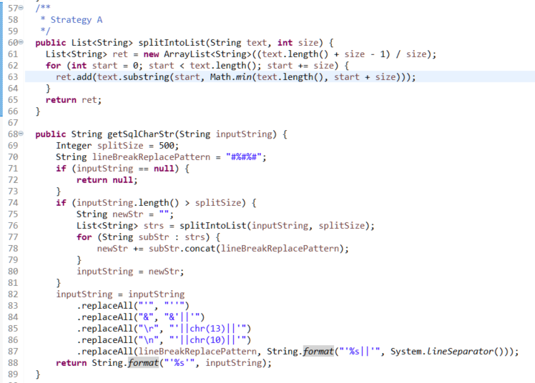
Strategy A : Code

Slide 9
Strategy A : Review
Do we need to store the fragments into a list for our further processing?
Creating objects like ArrayList isn’t free, especially when you need to do it 1.8G times
Strategy could be changed as follows:
For each 500 characters in the input string
Perform the replacement
Join the output by the specified pattern

Slide 10
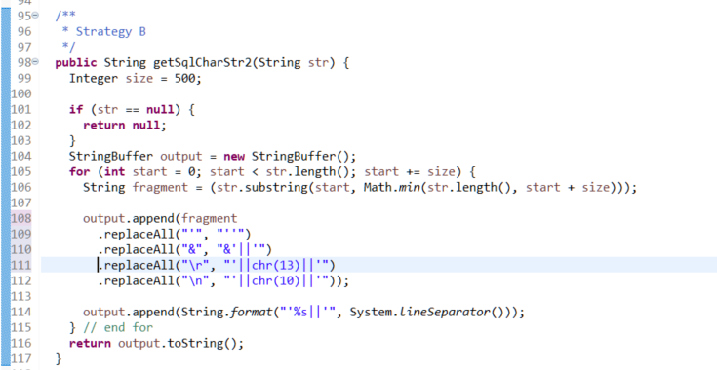
Strategy B: Split and Merge on-the-fly

Slide 11
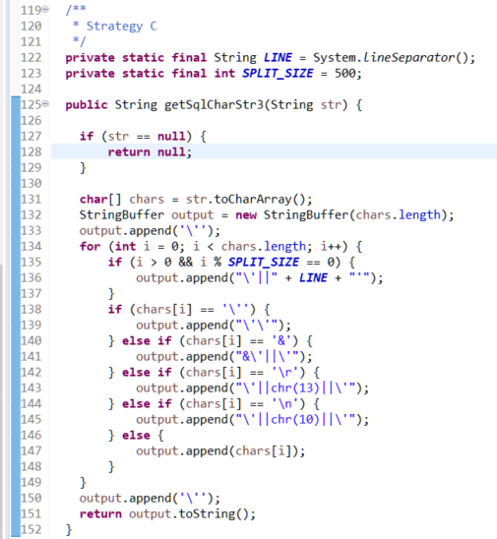
Strategy C: Operate on the char array instead

Slide 12
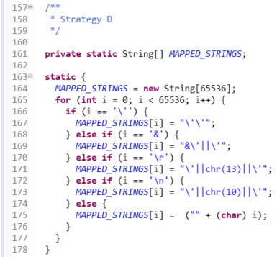
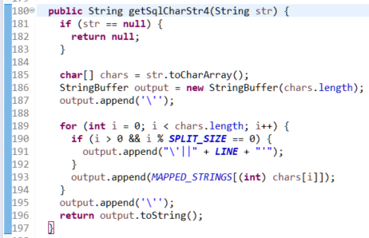
Strategy D: A “caching” approach

Slide 13
Question
Which of the above Strategies run fastest?
Strategy A: Split into list, merge, join
Strategy B: Split, merge, join on-the-fly
Strategy C: Split, merge, join, working on the char array
Strategy D: Pre-calculate all outputs, split, merge, join on-the-fly on the char array

Slide 14
Tuning Demo 1

Slide 15
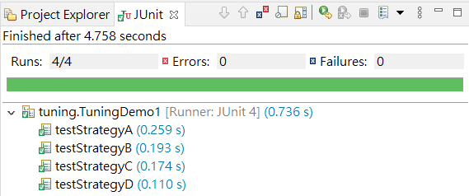
Demo 1 : JUnit
Strategy D looks fastest if you run the Junit Test
It is faster by a “little bit”
Note also that the result is different for every test
How can we sure the result is not due to variances?

Slide 16
Demo 1 : JMH
JMH (Java Microbenchmark Harness
https://www.baeldung.com/java-microbenchmark-harness
https://github.com/openjdk/jmh
According to benchmark result, strategy C is the fastest
Benchmark Mode Cnt Score Error Units
TuningDemo1.testStrategyA avgt 5 0.091 ± 0.008 s/op
TuningDemo1.testStrategyB avgt 5 0.085 ± 0.046 s/op
TuningDemo1.testStrategyC avgt 5 0.038 ± 0.004 s/op
TuningDemo1.testStrategyD avgt 5 0.056 ± 0.009 s/op

Slide 17
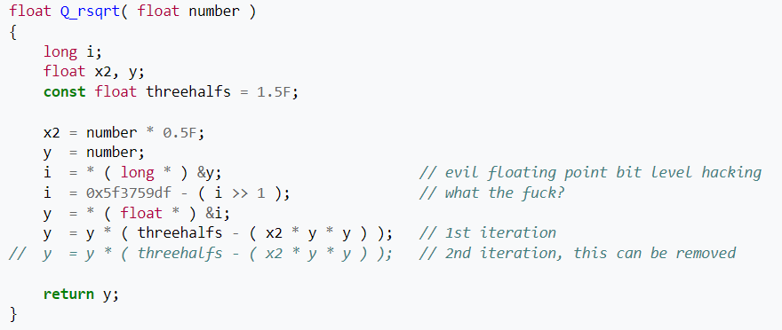
Demo 1 : Conclusion
Strategy B is strictly better than strategy A, since it does not have any assumption in the input string. (Occam’s Razor)
Strategy C is the fastest implementation.
Code clarity is STILL a matter and performance should not always supersede.
Try to read this code.
What does it do?

Slide 18
Lesson
The KISS principle prevails
Do NOT create unnecessary objects
Do NOT perform unnecessary actions
Keep It Simple, Stupid

Slide 19
Scenario 2: DCM Conversion
You are provided a table T1 such that
T1 contains 600M records.
T1 contains a primary key and the primary key range is known in advance
For each record r in the table, you would need to
Generate a JSON of r
Write the JSON of r to a file, each record will be in a separate line
That file should not be larger than 50MB
If the file is larger than 50MB, the next JSON will be written to the next file and so on.
The first file should be named T1_expectedResult.txt. If that exceeded 50MB, the output should go to T1_expectedResult_2.txt etc
Generate an insert SQL that will insert into table T2 where T2 contains a subset of columns of T1
Describe your strategy.

Slide 20
Example
Suppose we have the following table T, where E is known to be the primary key of the table
What we want is the JSONs, for example {"A":"中文", "B":"Y", "C":"Remarks:", "D":"SLP", "E": 1}
We also want an insert SQL into another table
A | B | C | D | E
中文 | Y | Remarks: | SLP | 1
中文 | N | 中文 | ZSLP | 2
English | Y | Hello | ZSA | 3
English | N | 中文 | ZAR1L | 4
French | Y | World | ZAR1LS | 5

Slide 21
Strategy 2A: Naive
For each record r in T1
Use GsonUtil to generate a JSON from r
Write an insert SQL that could be run in SQLPlus which will insert r to another table T2 which has a subset of columns of T1
Write the JSON of r to a file
If the file is over 50MB, switch the file to be written to another file (BufferedWriter)
Question: Can we do better?

Slide 22
Performance : Study the Bottleneck
Use profiler tools, or add logs to the code to see the bottleneck of the code
Check where the most time is spent on and attempt to tune that area first.
It serves no purpose to tune the code where 1% of the time is spent, while leaving the code where 99% of the time is spent untouched

Slide 23
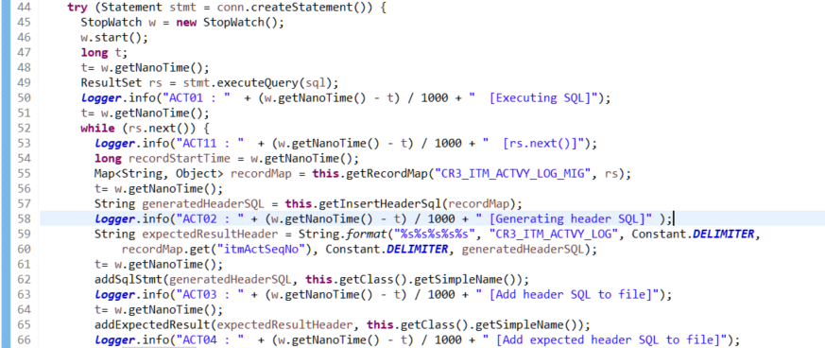
The Original Code

Slide 24
Profiling
A data set of 500k records are tested and the test requires 1671 seconds to complete
It could be seen that according to the logs, ACT11 is taking most of the time, in one order of magnitude higher than all the others.
ACT01 185960050
REC 321555341
ACT10 11102138
ACT11 1251906698
ACT02 6600809
ACT03 98336117
ACT04 90207420
ACT05 1957365
ACT06 21509993
ACT07 21102430
ACT08 1189094
ACT09 11162413

Slide 25
Profiling
ACT11 is the time required for ResultSet.next()
It can be seen every 10th call will cost an exceptionally amount of time

Slide 26
Profiling
20200914 17:18:10.353|main|INFO |DCRA31 - ACT11 : 23414 [rs.next()]
20200914 17:18:10.354|main|INFO |DCRA31 - ACT11 : 387 [rs.next()]
20200914 17:18:10.354|main|INFO |DCRA31 - ACT11 : 210 [rs.next()]
20200914 17:18:10.355|main|INFO |DCRA31 - ACT11 : 148 [rs.next()]
20200914 17:18:10.355|main|INFO |DCRA31 - ACT11 : 163 [rs.next()]
20200914 17:18:10.356|main|INFO |DCRA31 - ACT11 : 141 [rs.next()]
20200914 17:18:10.356|main|INFO |DCRA31 - ACT11 : 134 [rs.next()]
20200914 17:18:10.357|main|INFO |DCRA31 - ACT11 : 199 [rs.next()]
20200914 17:18:10.357|main|INFO |DCRA31 - ACT11 : 162 [rs.next()]
20200914 17:18:10.358|main|INFO |DCRA31 - ACT11 : 135 [rs.next()]
20200914 17:18:10.377|main|INFO |DCRA31 - ACT11 : 20144 [rs.next()]
20200914 17:18:10.379|main|INFO |DCRA31 - ACT11 : 272 [rs.next()]
20200914 17:18:10.379|main|INFO |DCRA31 - ACT11 : 247 [rs.next()]
20200914 17:18:10.379|main|INFO |DCRA31 - ACT11 : 216 [rs.next()]
20200914 17:18:10.379|main|INFO |DCRA31 - ACT11 : 212 [rs.next()]

Slide 27
JDBC Fetch Size
10 is the default fetch size for ResultSet in Oracle.
It follows that every extra fetch is costing much time, summing up to a huge amount
We need to change this fetch size to a higher value.
Since DCM process is a batch program, we can afford the memory required for speeding up.

Slide 28
Tuning Demo 2

Slide 29
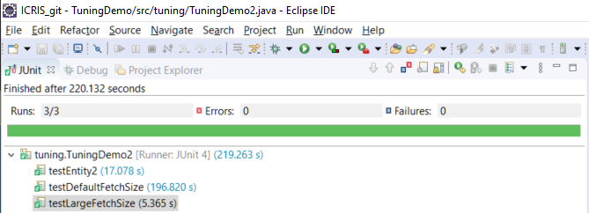
Demo 2 : Conclusion
The performance of the default fetch size is at least one order of magnitude slower

Slide 30
Demo2 : JMH
Benchmark Mode Cnt Score Error Units
TuningDemo2.testDynamicFetchSize avgt 5 12.015 ± 7.409 s/op
TuningDemo2.testLargeFetchSize avgt 5 9.224 ± 8.379 s/op

Slide 31
Lesson
Set fetch size according to your needs
Set fetch size to a large value for batch processing
Use the calls provided by others (e.g. selectForList in Entity 2.0) instead of writing your own.

Slide 32
JDBC Fetch Size
After setting fetch size to 5000 and retest on the data set of 500k records, the test can be completed in 457 seconds.
Comparing to 1671 seconds before, we are around 2.5 times faster than before.
Using the profiling approach again, we found that checking the file size is 50MB each is spending a lot of time
Next, we will explore the strategy of determining file size.

Slide 33
Check File Size
The original approach:
Get a BufferedWriter w for T1_expectedResult.txt
For each record r in T1
Write the JSON of r to w
After writing, list the files L in the output folder with name T1_expectedResult*.txt
Get the file with the largest number in the list L, let it be f
If the file size of f exceeds 50MB, create the next file and open a BufferedWriter w
Question: Can we do better?
Question: How many times do we need to consult the file system if there are 600M records in T1?

Slide 34
Check File Size
Note that we need to consult the file system 600M times if there are 600M records in T1.
The approach is great if we are going to find the file size of the last file that we are writing.
However, this is not the best approach if we are going to find the file size of the file that we are currently writing.
We know the file name of the file we are currently writing and should not need to browse the file system.
Use CountingOutputStream from Apache that counts the number of bytes written instead of browsing file system for each record.

Slide 35
Parallel
Since we know that T1 has a primary key, we can use this primary key to partition the table and perform the task in parallel.
Suppose we have 600M records, we can use 50 processes. Each process will handle a different range of primary keys.
Each process will only need to dump 12M records to JSON.
Since we are performing a batch process, we could use the CPU and RAM resource to speed up.

Slide 36
Parallel
Some sample results of using parallelism.
Total Number of Records | Process | Time (seconds)
5M | 1 | 480
5M | 5 | 120
6M | 6 | 159
10M | 10 | 281
40M | 5 | 1320
40M | 40 | 786

Slide 37
JDBC Upper Bound
Using parallelism, we could process 600M records using 40 processes in 12183 seconds (i.e., 3.38 hours).
We want to assess can we do better?
Suppose we just loop through 600M records and does nothing except dumping the JSON, what is the time required?
This is the upper bound of the conversion since we must need to loop through every record at least once via ResultSet and dump the JSON.
By testing, we could process 10M records in 65 seconds.
However, compare to the chart previously, we need 281 seconds to complete the conversion.
Where is the time sink?

Slide 38
Generate SQL
For each column in each record, we used the Strategy A to generate the SQL from the input string
We used a faster strategy to generate the SQL from the input string, and indeed saw a noticeable performance gain on a large data set.
The faster strategy improved over one hour over strategy A on a 600M dataset.

Slide 39
Scenario 3
Suppose we have 600M JSONs in files, each with a primary key and some column values.
Each line in the file is a JSON.
The primary keys of the JSONs in the file are assumed to be sorted.
We know the source of table where the JSONs are selected from.
For each JSON, we would like to retrieve the data from database using the primary key in the JSON. Then we dump the record as JSON in an output file.
Describe your strategy.

Slide 40
Example
Suppose we are given the JSON, which we know is from table T
{"A":"中文", "B":"Y", "C":"Remarks:", "D":"SLP", "E": 1}
Our goal is to use JDBC to select from the table T where the primary key (E) is equal to 1, and check the fields A, B, C, D and see whether the fields are equal to the ones in the JSON.

Slide 41
Strategy 3A: Naive
For each line in the input file
Read the JSON as object
Select from the database using the primary key in the JSON
Dump the database result to JSON
Can we do better?
Thoughts: How many times would we need to select from the database if we have 600M records?

Slide 42
Tuning Demo 3

Slide 43
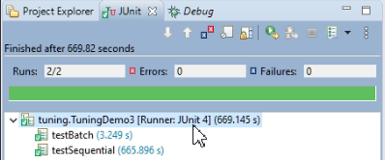
Demo3 : Conclusion

Slide 44
Lesson
NEVER run SQL query inside a loop if you can.
You should NOT write N+1 patterns even in online systems.
Run queries in batch, e.g., executeBatch in JDBC
Use selectForMap / selectForList to get all the information required, and lookup the information from the map.

Slide 45
Strategy 3B
For each line in the input file
Add to batch with primary key
If batch exceeds a certain size
Use selectForList to retrieve the database records using the primary keys in the batch
Clear the batch
Execute the last batch if not empty

Slide 46
N +1 patterns : other examples
DO NOT
For each document barcode in a list L
Select the doc_sht_frm from cr3_doc
Select the short form record from cr3_ref_doc_sht_frm as r
Save the case_typ of r in a list
Return the list r
DO
Retrieve the case_typ of cr3_ref_doc_sht_frm in a list using a single SQL by joining table and return the list

Slide 47
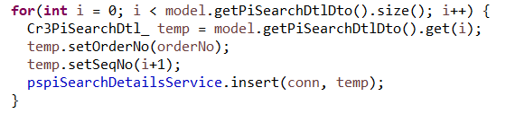
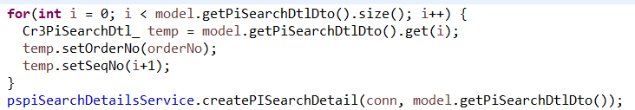
N +1 patterns : other examples
DO NOT
DO Use the insert list method in BaseDaoImpl

Slide 48
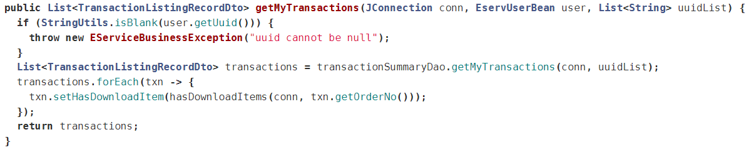
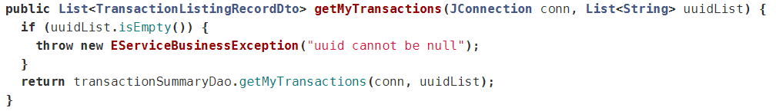
N +1 patterns : other examples
DO NOT
DO Use SQL to resolve the hasDownloadItem or retrieve all information required and use Java to build the hasDownloadItem status

Slide 49
Scenario 4
You are provided a Java method boolean scanChinese(String inputString) that will tell you whether the inputString contains a Chinese character which is “out of range”.
You need to use this function to find all records in all tables under a certain schema such that at least one of the column contains an “out of range” Chinese character, and also which column contains an “out of range” Chinese character.
You did not know which column is storing Chinese character or not.
The goal is to minimize the number of calls to scanChinese function.
Describe your strategy.

Slide 50
Example
Suppose we have the following table T, where E is the primary key
We would like to scan the 4 VARCHAR2 columns to see whether they are “out of range”
A | B | C | D | E
中文 | Y | Remarks: | SLP | 1
中文 | N | 中文 | ZSLP | 2
English | Y | Hello | ZSA | 3
English | N | 中文 | ZAR1L | 4
French | Y | World | ZAR1LS | 5

Slide 51
Strategy 4A: Naive
For each table t under the schema
For each column c in the table t
If c is a character column (e.g., VARCHAR2)
Retrieve that column in JDBC
Apply scanChinese to the value in the database
Can we do better?
Thoughts: Can we select less results from the database from JDBC to call the scanChinese method?

Slide 52
Hint
We cannot select every table, every column and every records in the database.
That alone take days of time
Note that we are only interested in Chinese characters
An “out-of-range” Chinese character is a Chinese character.
A Chinese character is a multi-byte character
A column col in a table contains a multi-byte character if and only if lengthb(col) != length(col)

Slide 53
Strategy 4B: Filter multibyte columns
Find out all tables and columns (t,c) with possible Chinese characters and store the list as L
For each (t,c) in the list L
Retrieve all records for column c in table t in JDBC
Apply scanChinese to the value in the database
Thoughts: How can we find the target list?

Slide 54
Find out Chinese columns
Query database for candidate Chinese columns
-- Generate a SQL to find chinese characters in all columns in all tables
select
'select count(*) '
|| ', ''' || table_name || ''' as table_name'
|| ', ''' || column_name || ''' as column_name'
|| ' from ' || table_name
|| ' where length(' || column_name || ') != lengthb(' || column_name || ')'
|| ' having count(*) > 0'
|| ';'
as sql
from
all_tab_columns
where owner = 'ICRISDBA'
and data_type in ('CHAR', 'VARCHAR2');

Slide 55
Find out Chinese columns
How many times do we query for database for finding Chinese columns?
How many times do we query for database for finding data with Chinese characters?
How many times do we call the scanChinese method?
Can we do better?

Slide 56
Reduce the search space
Suppose for a table t, there are 4 VARCHAR2 columns (A,B,C,D), 5 rows of record like this, E is the primary key of the column
Strategy 4A will perform scanChinese on all 20 strings
Strategy 4B will perform scanChinese on 10 strings (only column A, C, but for all records, including record with primary key 3 and 5)
Can we perform scanChinese 4 times only?
A | B | C | D | E
中文 | Y | Remarks: | SLP | 1
中文 | N | 中文 | ZSLP | 2
English | Y | Hello | ZSA | 3
English | N | 中文 | ZAR1L | 4
French | Y | World | ZAR1LS | 5

Slide 57
Strategy 4C: Pure JDBC
Select a “crafted” string output describing what fields contain multiple byte characters.
Run the SQL for each table in parallel.
In the result set, retrieve the crafted string that tells each possible multiple byte character in each record, and perform scanChinese.

Slide 58
Strategy 4C
Run the following SQL for each table t:
select
case when lengthb(A) != length(A) then ',A' end ||
case when lengthb(B) != length(B) then ',B' end ||
case when lengthb(C) != length(C) then ',C' end ||
case when lengthb(D) != length(D) then ',D' end as COLUMN_NAME,
t.* from t
where
1!=1
or lengthb(A) != length(A)
or lengthb(B) != length(B)
or lengthb(C) != length(C)
or lengthb(D) != length(D)

Slide 59
Strategy 4C
The sample result of the above SQL should looks like the following
Now by using JDBC to read COLUMN_NAME, and then the corresponding columns, we only need to pass the followings to scanChinese:
column A of primary key 1
columns A and C of primary key 2
column C of primary key 4
Note that we only need to issue one SQL for each table.
COLUMN_NAME | A | B | C | D | E
,A | 中文 | Y | Remarks: | SLP | 1
,A,C | 中文 | N | 中文 | ZSLP | 2
,C | English | N | 中文 | ZAR1L | 4

Slide 60
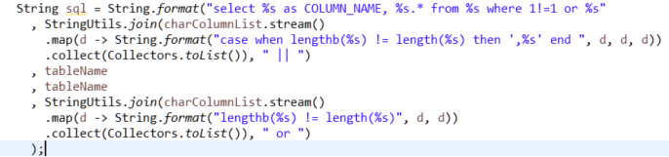
Strategy 4C
The Java implementation of the “crafted” SQL:

Slide 61
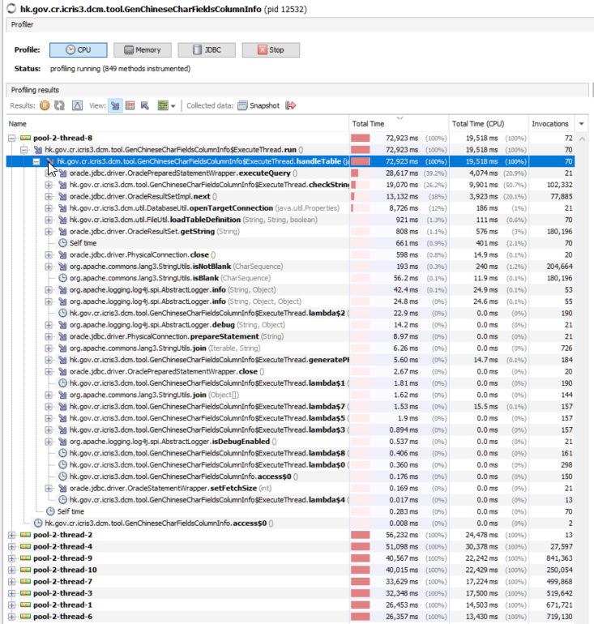
Scenario 5
After what you did in Scenario 4 , we still want more improvement in performance.
Run a profiler when the conversion is executing.
From the profiler, it is noted that the method checkString is taking up much time
Goal: find why checkString is taking up so much time

Slide 62
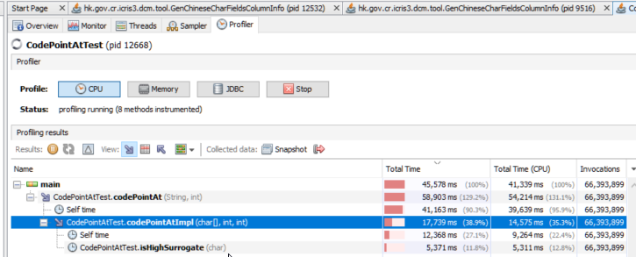
Profiler
Running a profiler against a simpler test program on checkString.
It can be seen that codePointAt is spending most of the time.

Slide 63
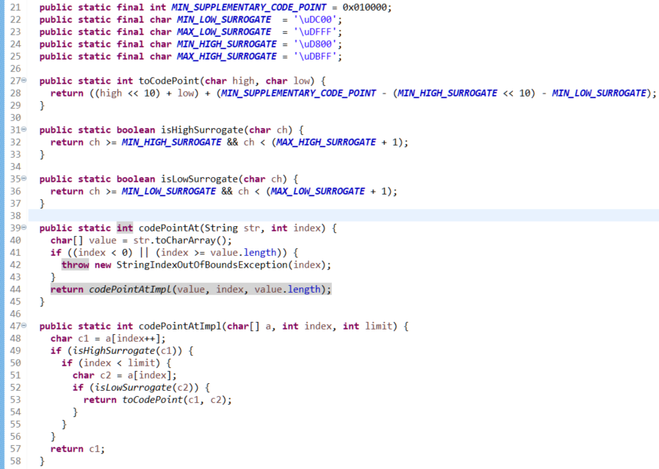
codePointAt
The Java source of codePointAt is listed.
Describe where the time sink of codePointAt is.
Can you rewrite codePointAt such that it could be more efficient?

Slide 64
Tuning Demo 4

Slide 65
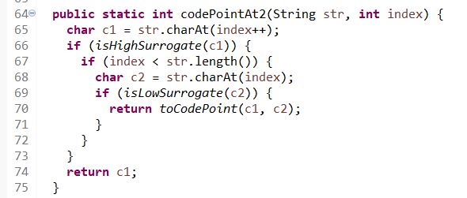
Demo4 : Conclusion
Benchmark Mode Cnt Score Error Units
TuningDemo4.testCodePointAtNew avgt 5 0.120 ± 0.009 s/op
TuningDemo4.testCodePointAtOld avgt 5 0.833 ± 0.102 s/op
By not creating a new char array for every call, we achieved a considerable speed boost.

Slide 66
Bonus Scenario
You are provided a REST API endpoint.
In your local environment, you issued a single request to the endpoint
It takes 11 minutes to return the result.
Describe your strategy to make it faster.

Slide 67
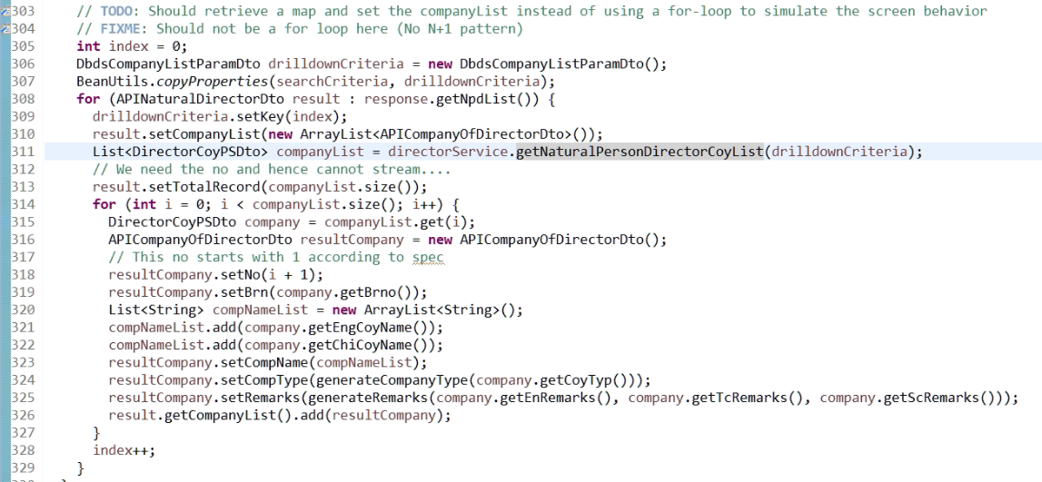
Profiler
Using a profiler, the following code took a lot of time.
What is going wrong and how can we do better?

Slide 68
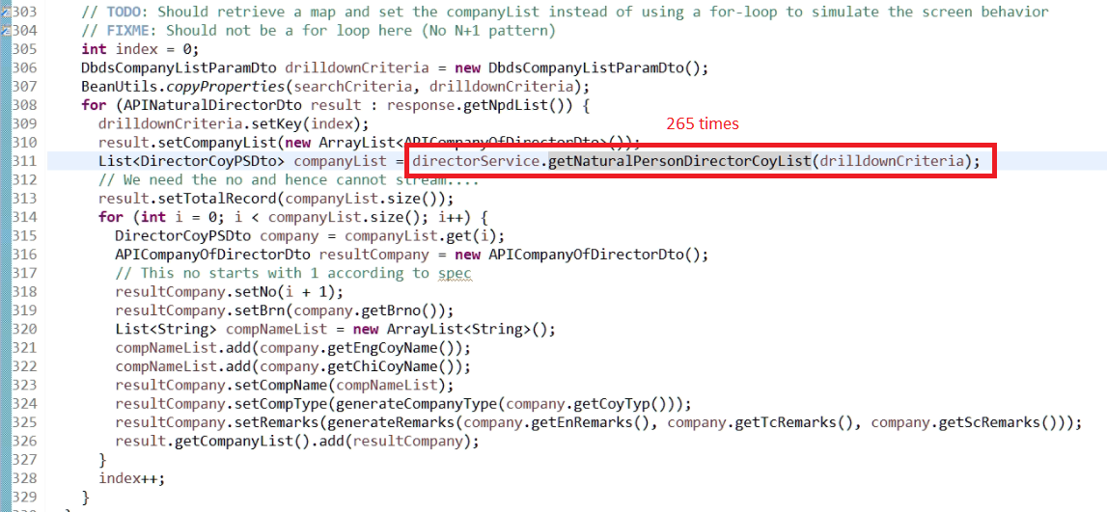
N + 1 Problem
In our test case, response.getNpdList() has 265 items!
We called database at least 265 times! (much more, will see later)

Slide 69
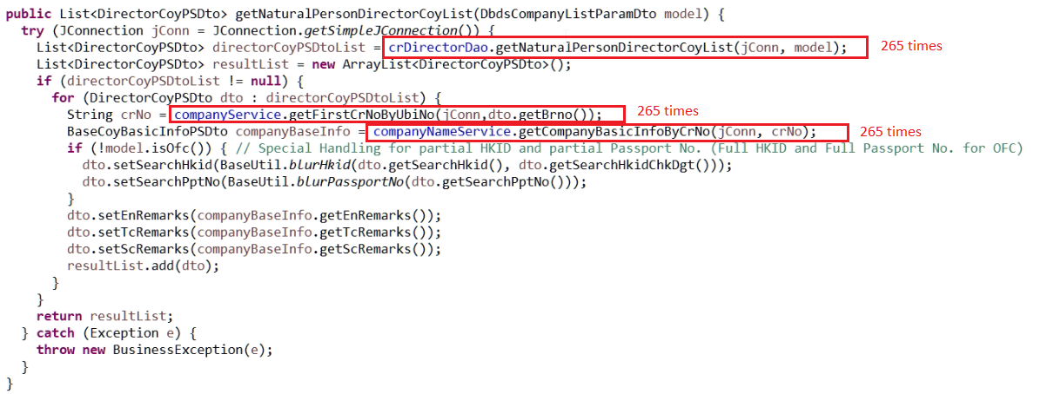
N + 1 Problem
Inside the service method, we can see that 265 x 3 database queries are issued.

Slide 70
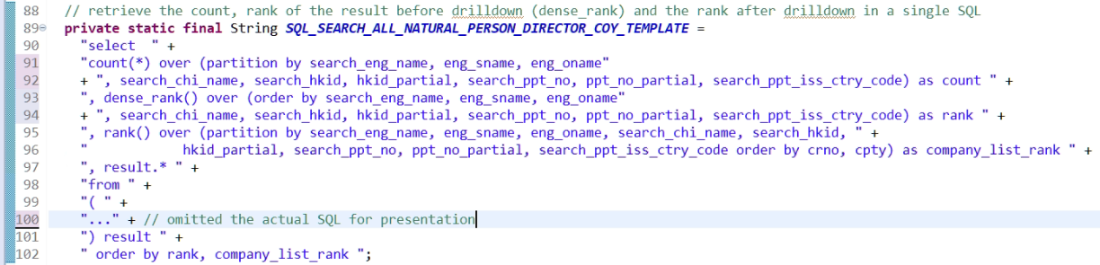
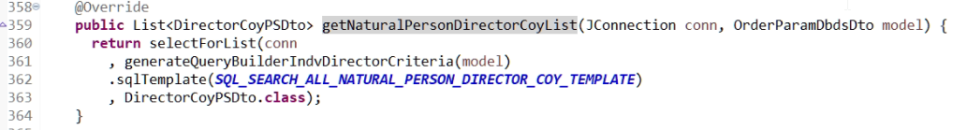
Remove the N+1 pattern
We should only perform only a fixed number of database queries.
Just return the result list for the service caller to parse the result list.

Slide 71
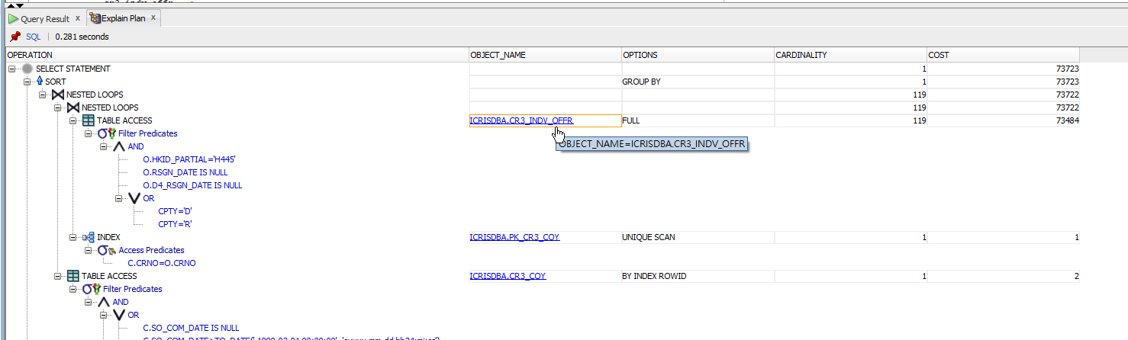
Index
By viewing the explain plan, we saw that our SQL is performing full table scans for 265 times which is also a huge time sink
We will add an index for HKID_PARTIAL in CR3_INDV_OFFR
Our main SQL changed from 3 seconds to 0.5 seconds.

Slide 72
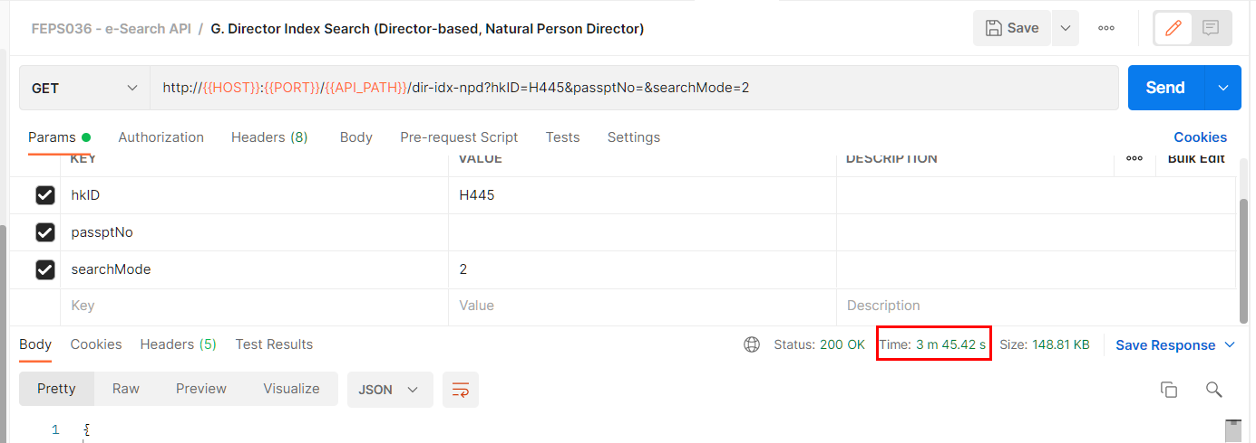
Performance : round 2
We removed the N+1 patterns, added the index and the endpoint API runs in 3 minutes.

Slide 73
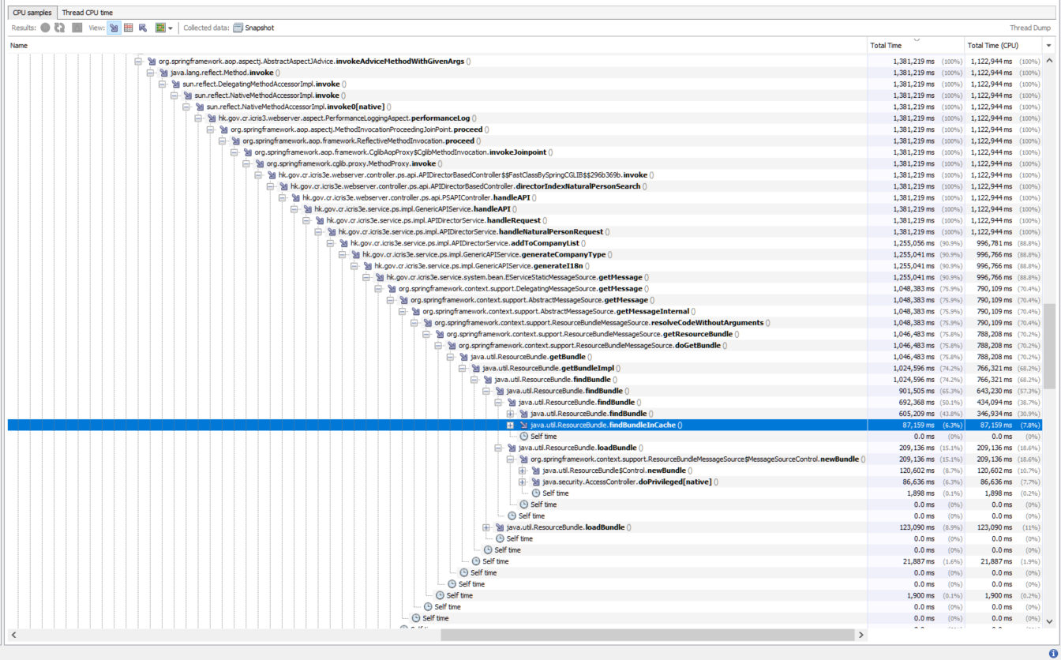
Profiler : round 2

Slide 74
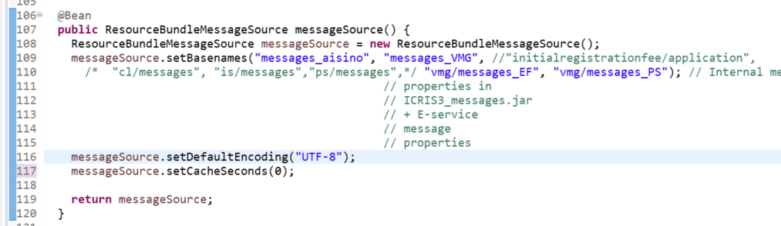
Spring MessageSource
This is the messageSource @Bean definition in Spring
Why is getMessage taking so much unexpected time?

Slide 75
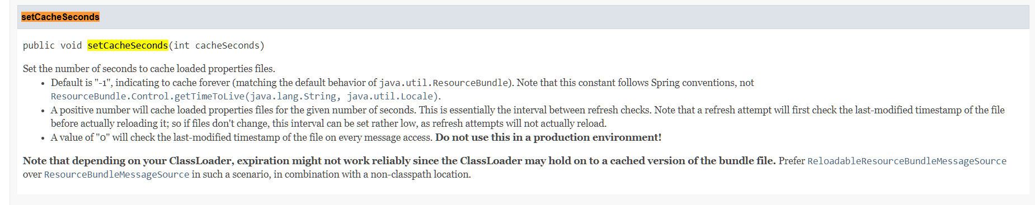
Spring MessageSource
Source: https://docs.spring.io/spring-framework/docs/current/javadoc-api/org/springframework/context/support/AbstractResourceBasedMessageSource.html#setCacheSeconds-int-
According to Spring doc, a cache seconds of 0 means no cache. It follows that we are reading the properties files for every property message lookup (another form of N+1 pattern)
We should set a value such that no repeated property lookup within the same request

Slide 76
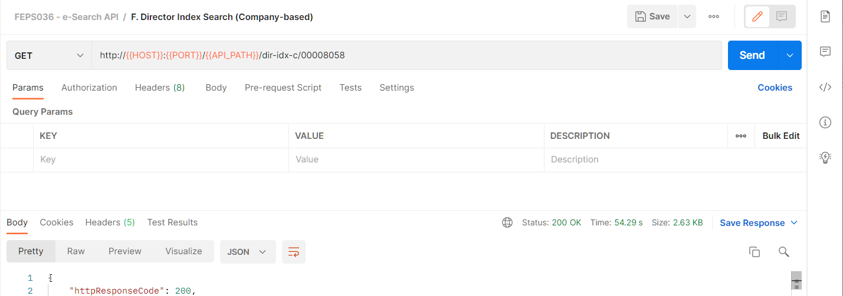
Performance : round 3
We set the cacheSeconds to 120 seconds.
The endpoint runs in 54 seconds

Slide 77
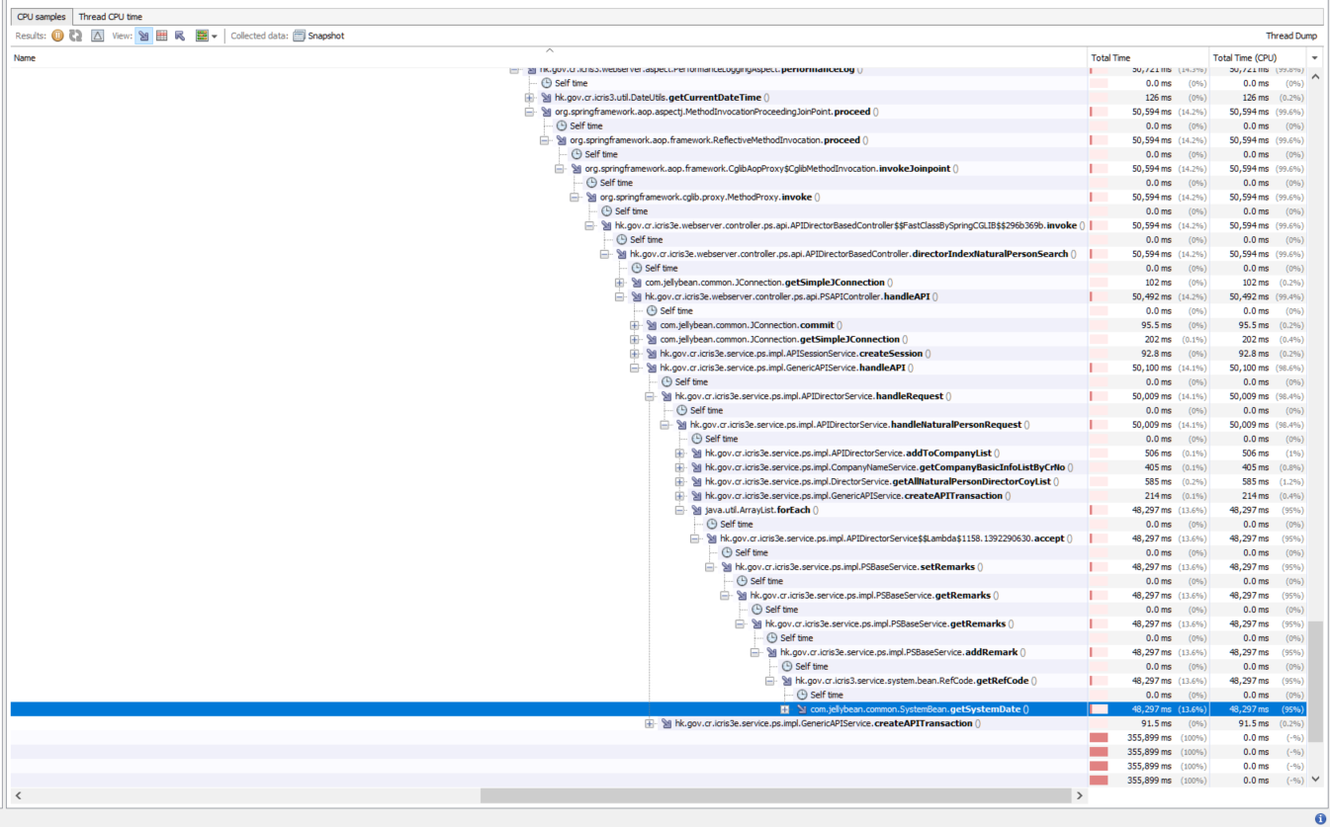
Profiler : round 3

Slide 78
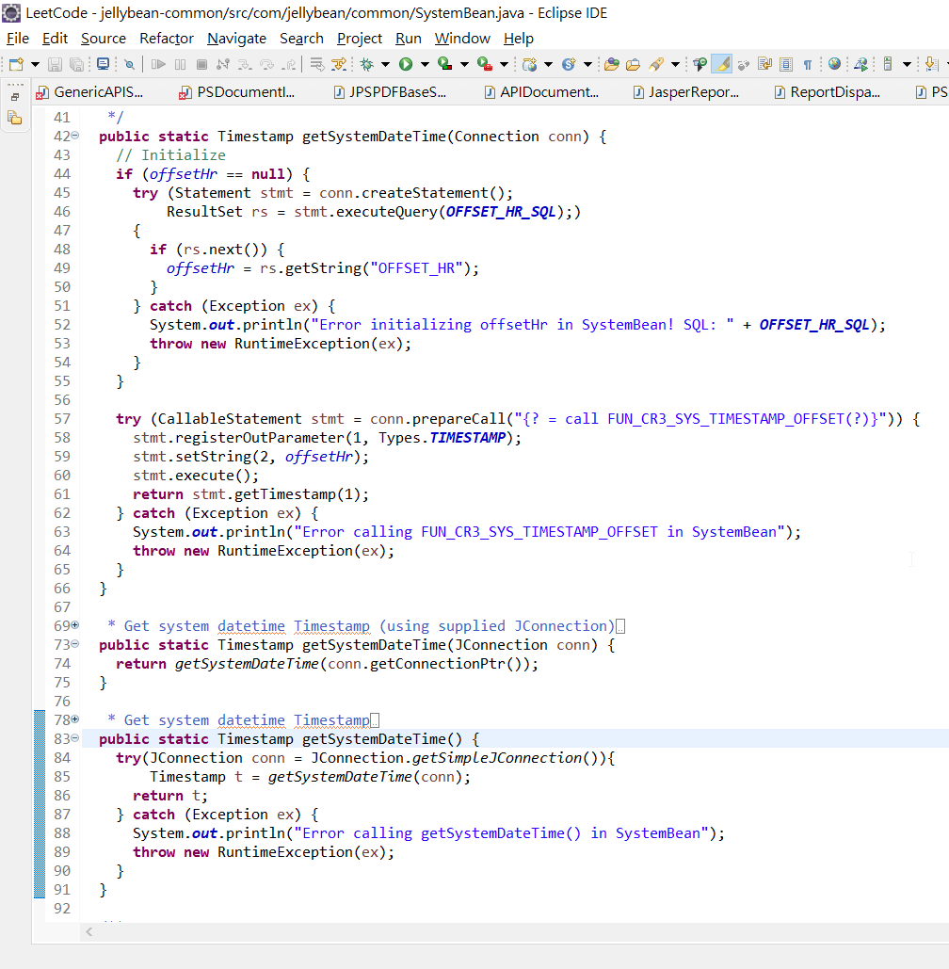
Profiler: round 3
Can you figure out why getSystemDateTime() is taking such a long time?

Slide 79
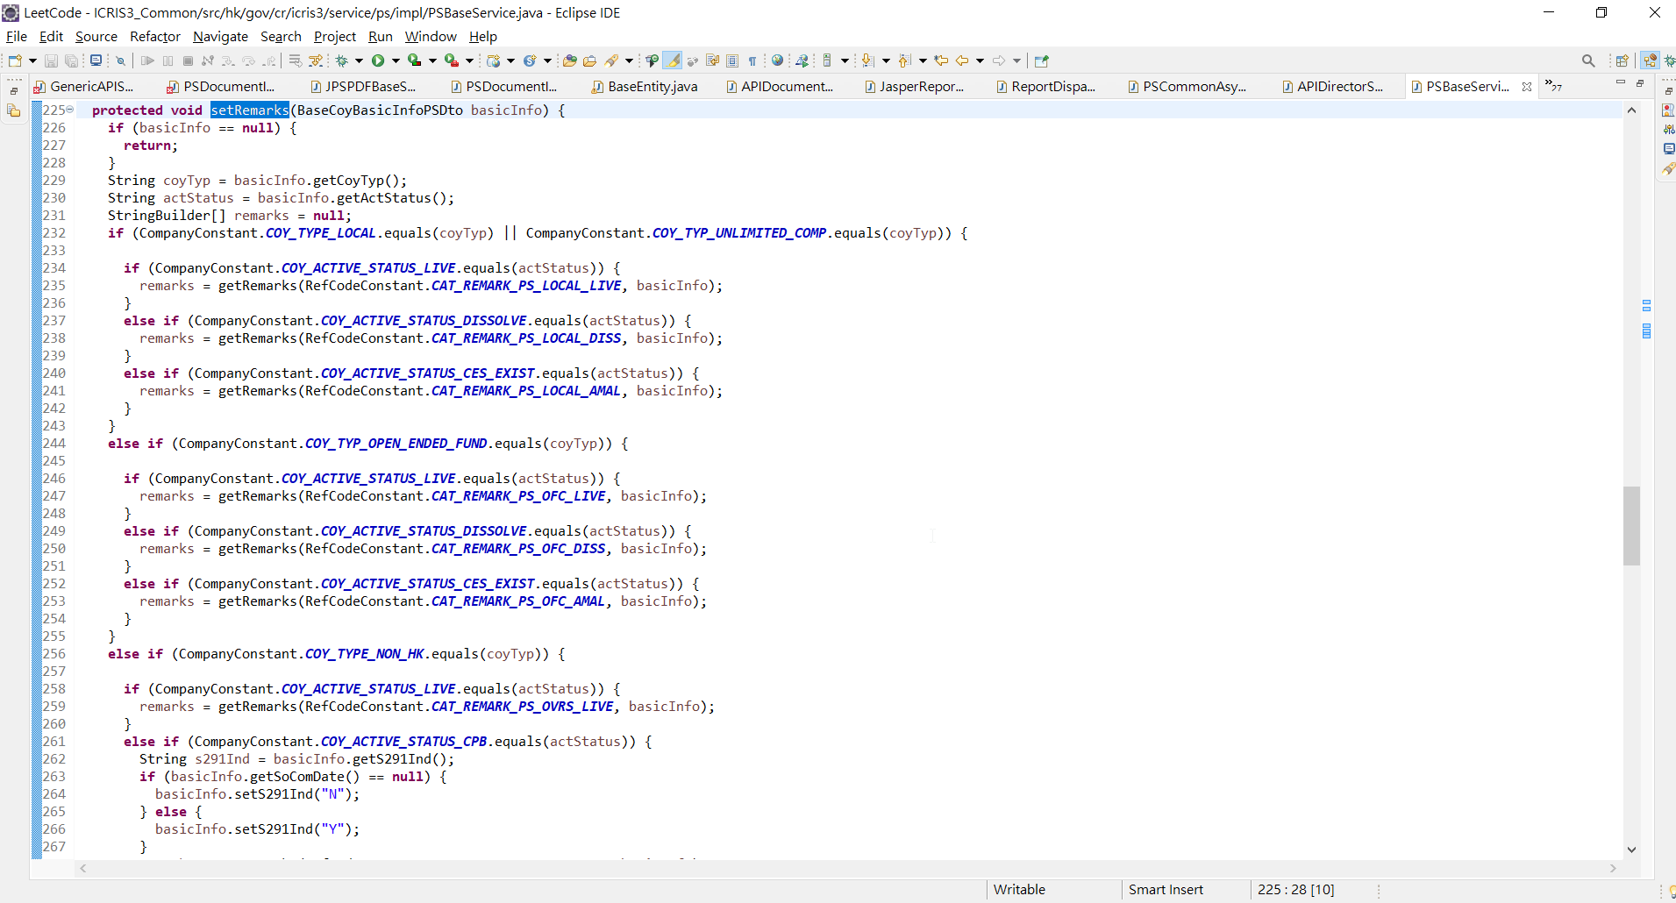
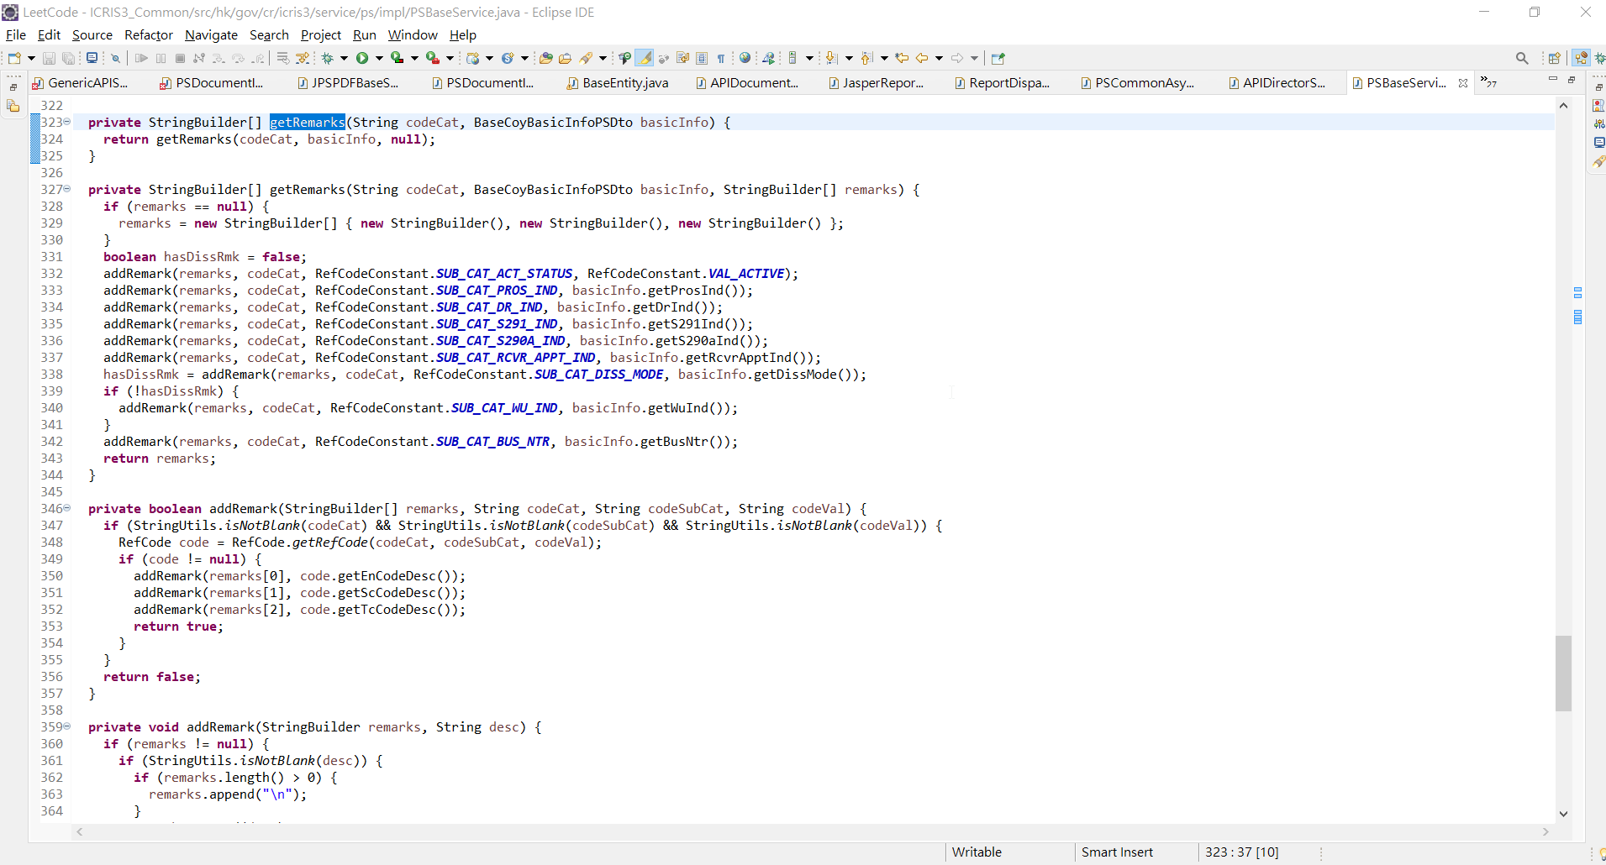
Implicit N+1 Pattern
Count how many database queries issued
9 Database queries
1 Database query

Slide 80
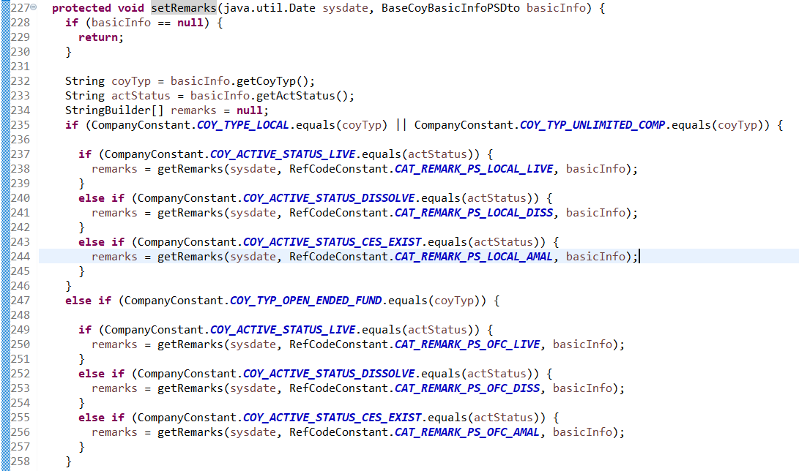
Remove the implicit N+1 Pattern
Retrieve the system date only once and pass to each getRemarks

Slide 81
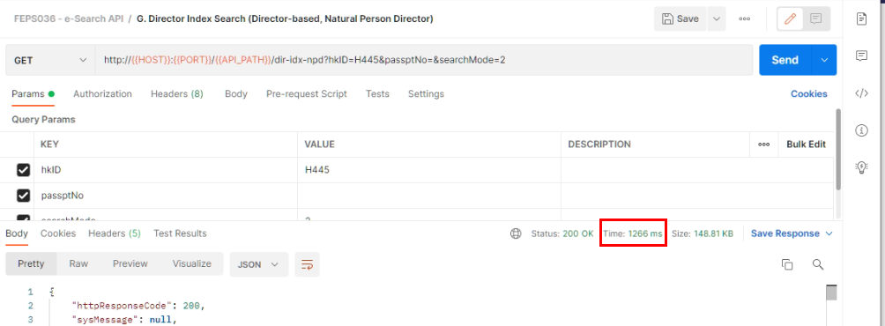
Performance : round 4
We removed the implicit N+1 pattern.
The endpoint runs in under 2 seconds.

Slide 82
Summary
KISS principle
80-20 principle
Do NOT create unnecessary objects
Do NOT perform unnecessary actions
Set JDBC fetch size
Use API calls or other libraries whenever appropriate
Know your limits
Reduce the search space if too large to handle
No N+1 patterns
Performance tuning is an iterative process

Slide 83
Resource
The tuning project, the presentation and other materials will be shared in
https://varmeego.sharepoint.com/:f:/s/Project-CRICRIS/ErBWT00dFRVMixdSzbiWOy0BU0mf786kAQ9DBNF0_8ZZxw?e=NN7IVE

